Slide 1
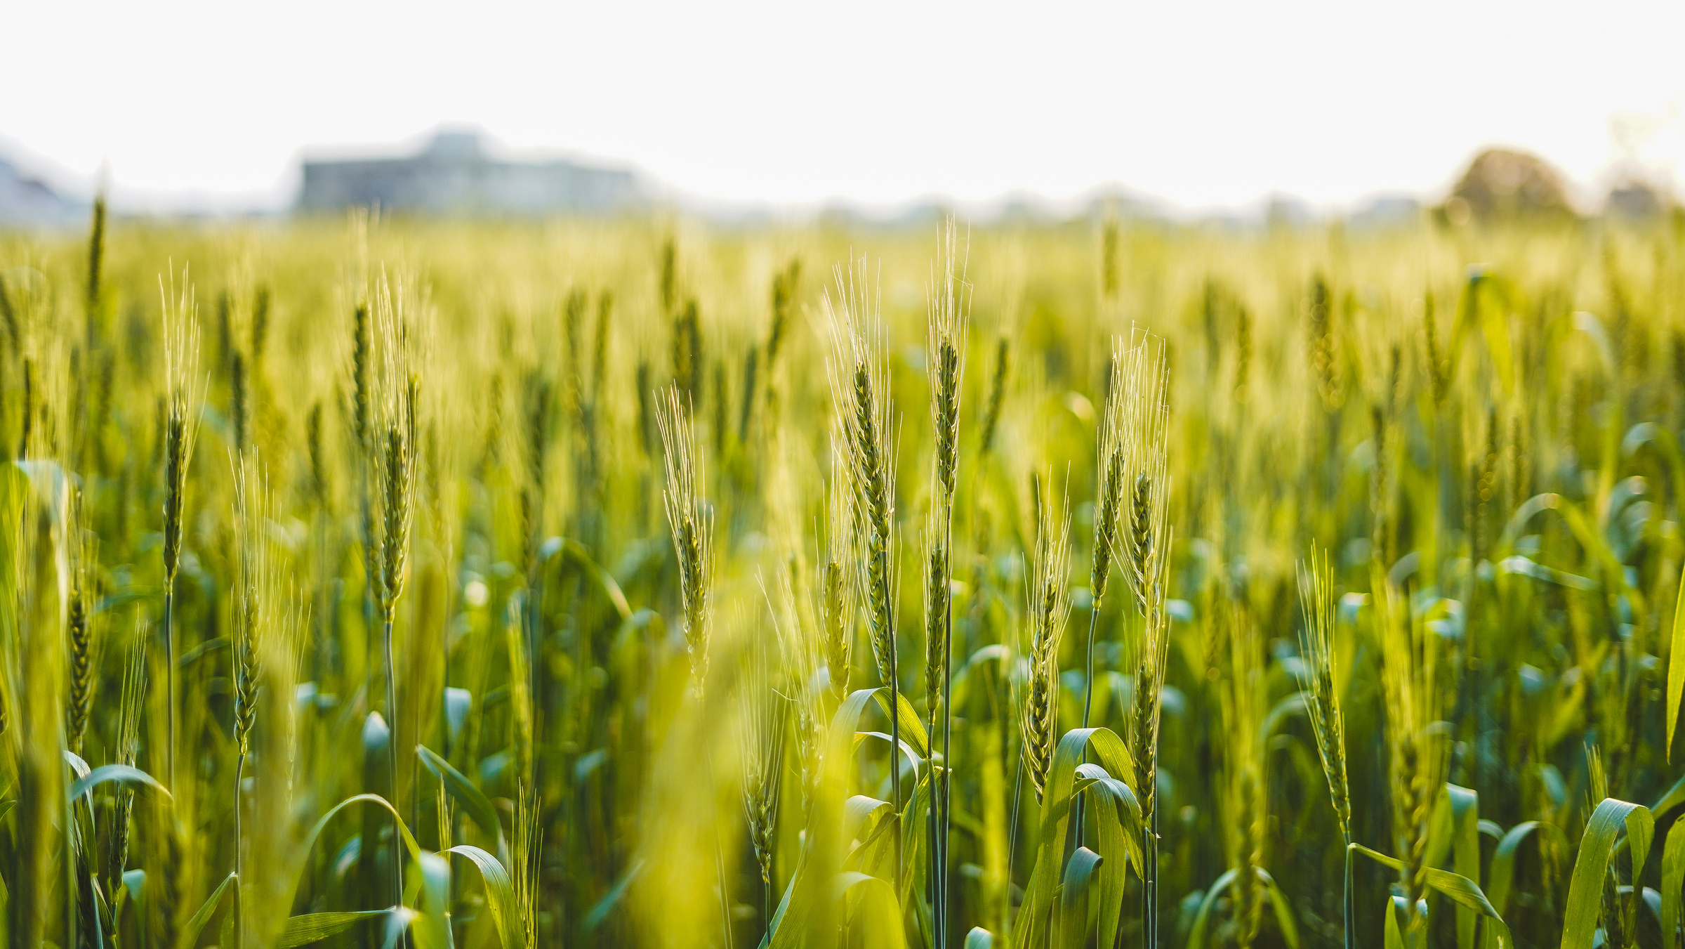



IEEE HACKATHON
Agritech
Group no.
BHL15
Group Members:-
Hemali Chautala (23BHI10073)
Aditya Singhal (23BHI10065)
Kaustubh Garg (23BCG1016)
Divesh Chaudhari (23BEY10074)
Paurush Nimje (23BCG10084)
Group Name :-
DataDynamos

Slide 2
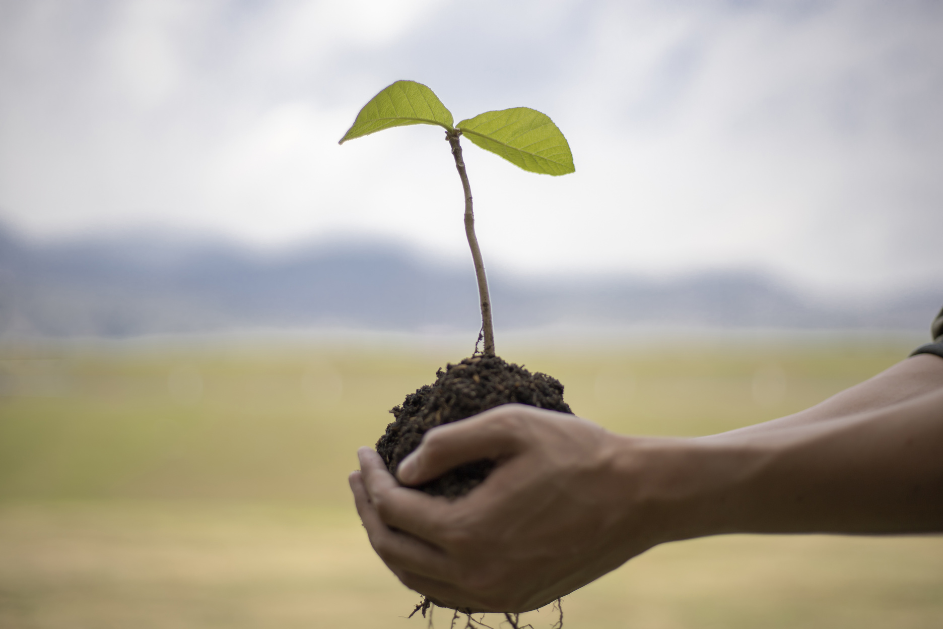
IEEE HACKATHON
Introduction
In today’s age food is one of the basic needs of the man which needs to secured by various means to avoid the conditions of famine and world hunger.
So we are introducing a ML model which will help the agriculture sector by giving farmers a helping hand to identify the various problems faced in farming methods and giving solutions to them, so they can implement it and improve there crop quality for maximum food production.

Slide 3
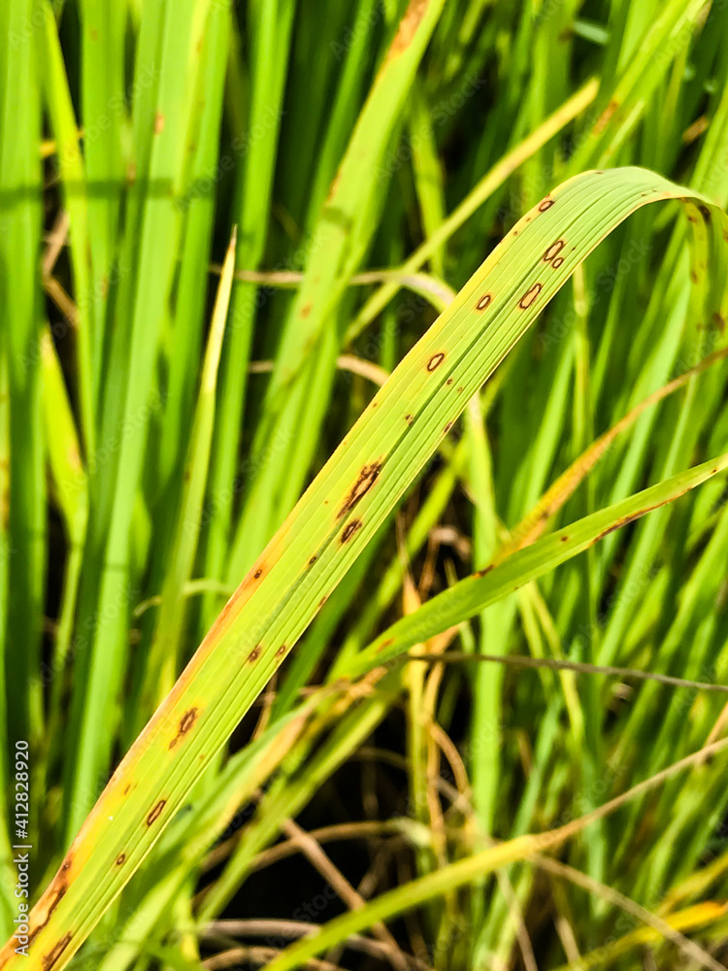
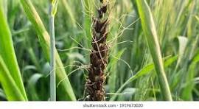
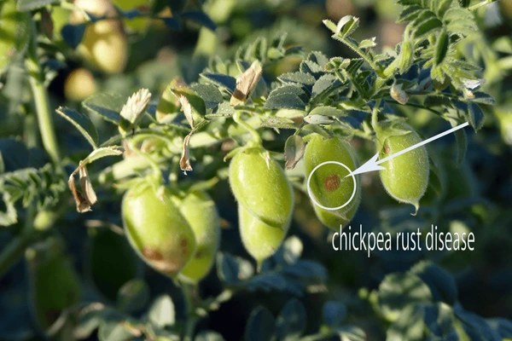
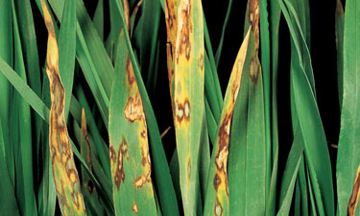
Rice blast on paddy crop
Brown Rust on wheat crop
chick pea rust
Leaf blotch on Barley crop

Slide 4
MACHINE LEARNING
ML TYPE
STEPS
PREDICTION AND CLASSIFICATION
LABELLED DATA USING SUPERVISED LEARNING
NATURAL LANGUAGE PROCESSING
Data collection (Disease data set).
Cleaning the data.
Integrating NPL to input symptoms.
Training the model using the available data.
Testing
DataDynamos
IEEE VIT Bhopal

